Slide 1

Data preparation: surrogate modeling of drainage networks under coastal flooding
Mohammad Movahhed
AI for Urban Water Networks
Instructor: Dr. Fan

Slide 2
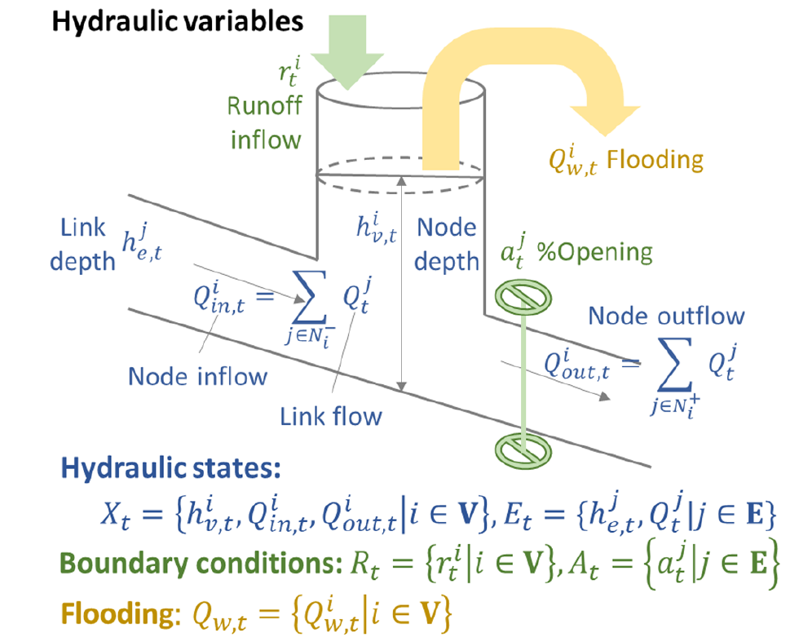
Recap
Accuracy
Physics-based modeling
Efficiency
Emerging Alternative
Surrogate modeling
Notes:
SMs are mathematical approximations employed to emulate a system’s behavior by learning the relationships between input parameters and output responses directly from precomputed simulations.

Slide 3
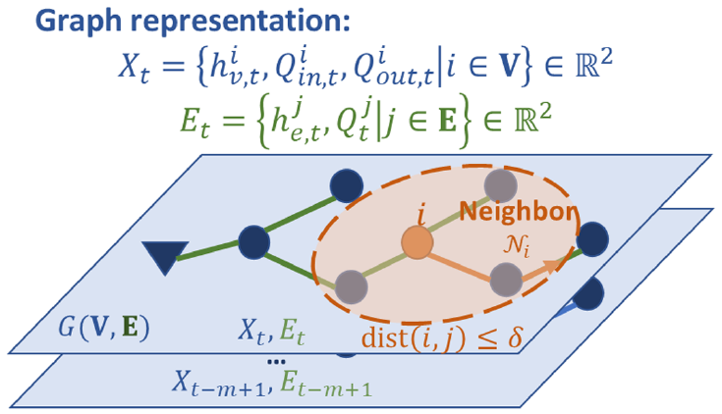
Recap
Surrogate modeling
Notes:
GNNs are ideal for this task since they are designed to process data over graphs by using the intrinsic structure of the network and the relations between network components.
Instead of connecting all the available features like a fully connected NN, a GNN focuses on the relationships and the corresponding parameters indicated by the graph they are representing.

Slide 4
Required Data
Storm surge
Flood model
Inundation time series
Topography
SWMM model
Network performance
Drainage network
New Storm
Surrogate model
Estimated performance
Notes:
Inundation time series & Drainage network (pipes, conduits, manholes, inlets, and outfalls)

Slide 5
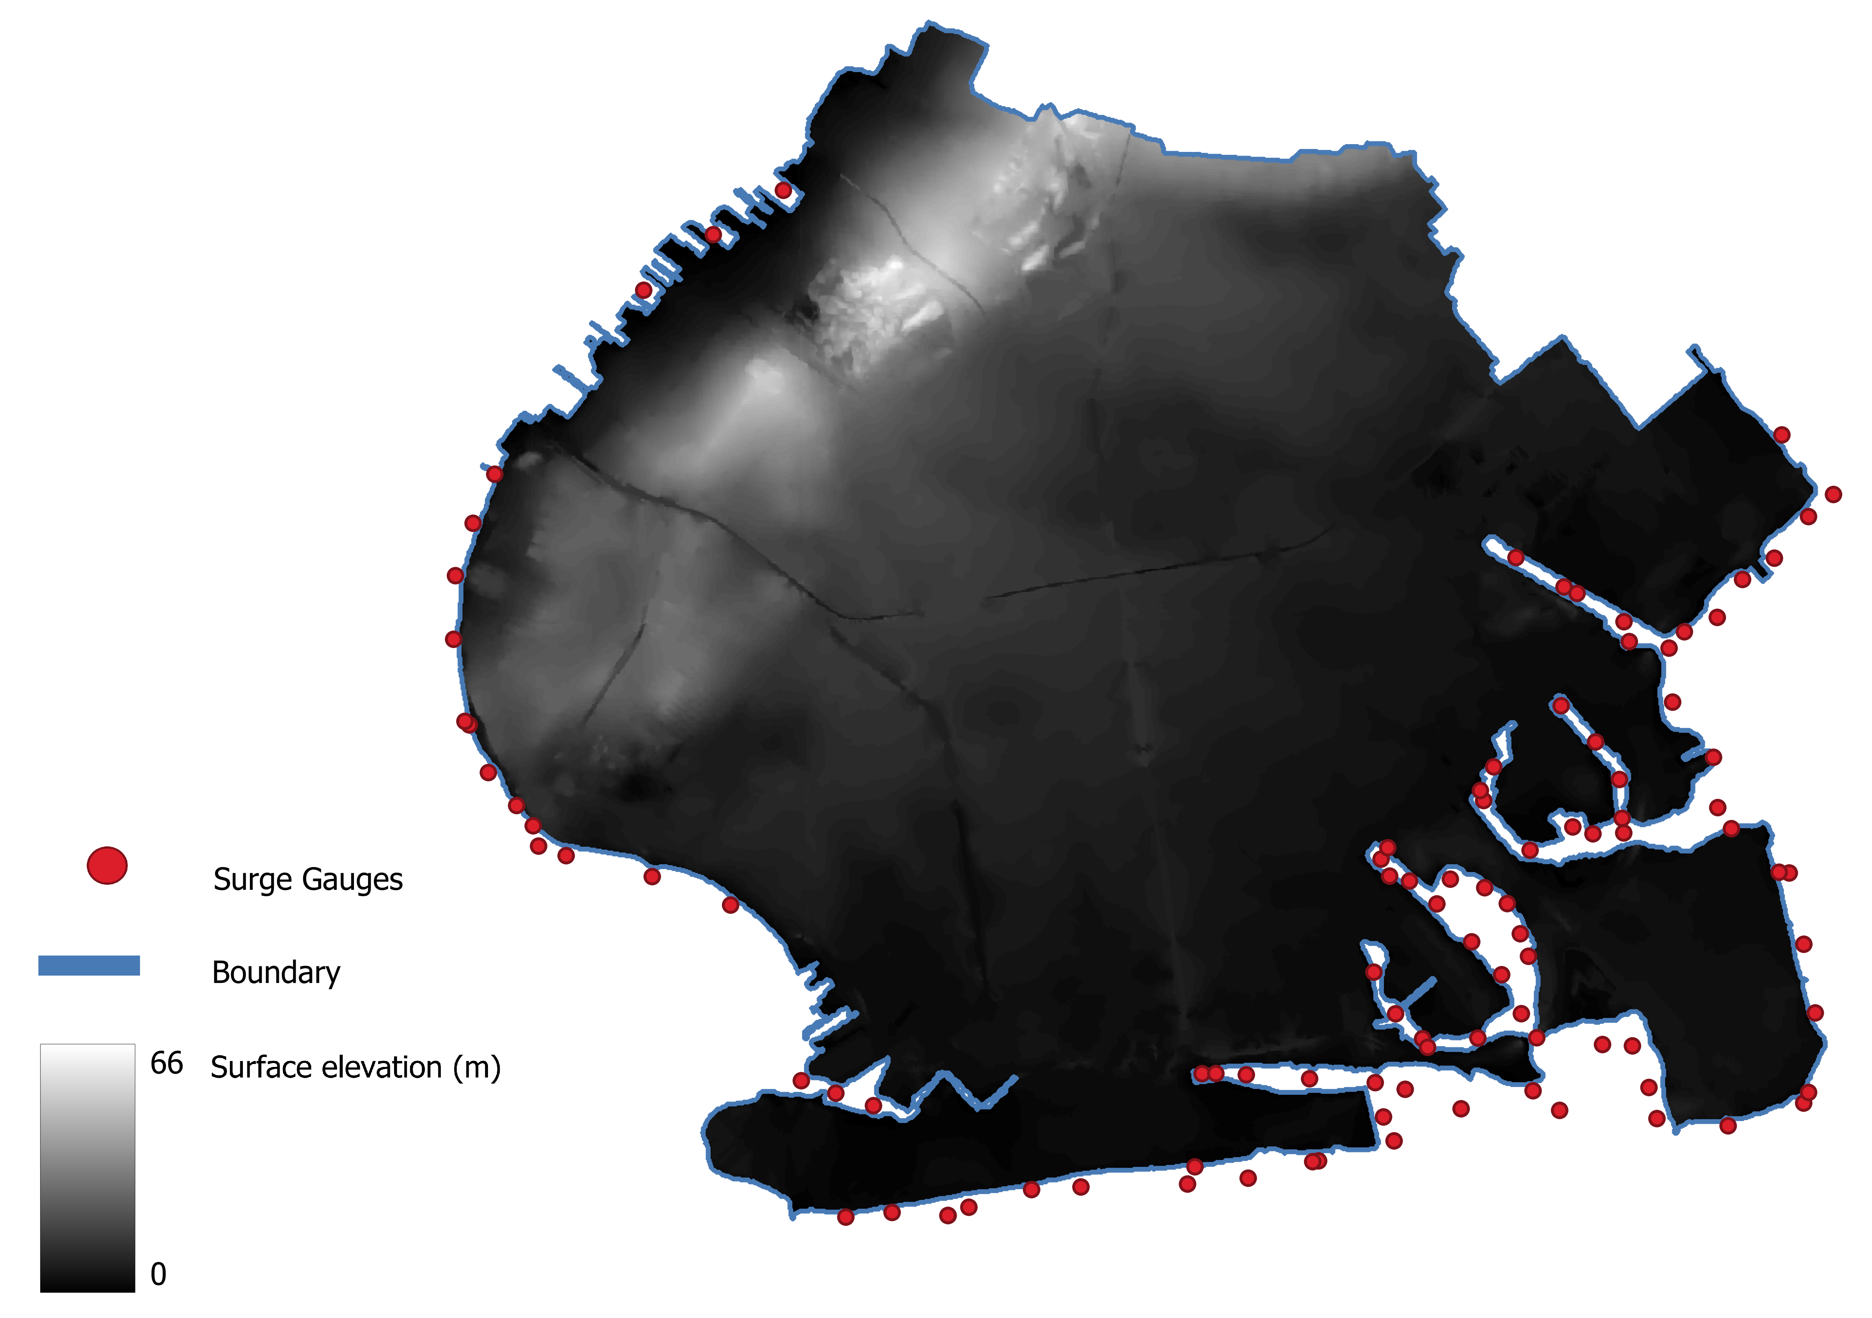
Real Case Study
Storm surge hydrograph (CHS database)
10-meter DEM (USGS database )
Notes:
Economically significant
Densely populated
In danger of hurricanes
Coastal Hazards System (CHS)

Slide 6
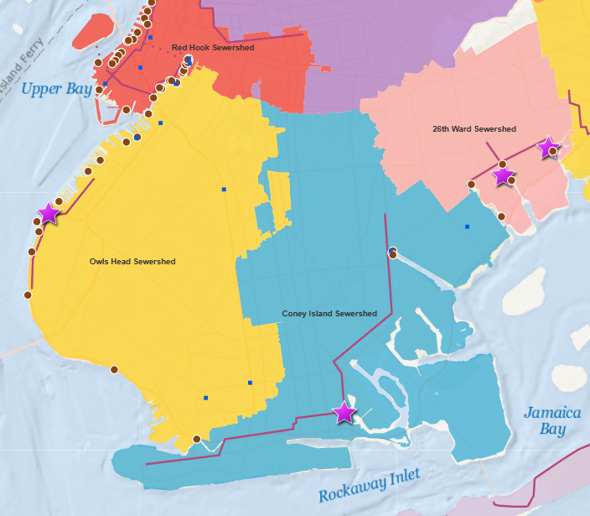
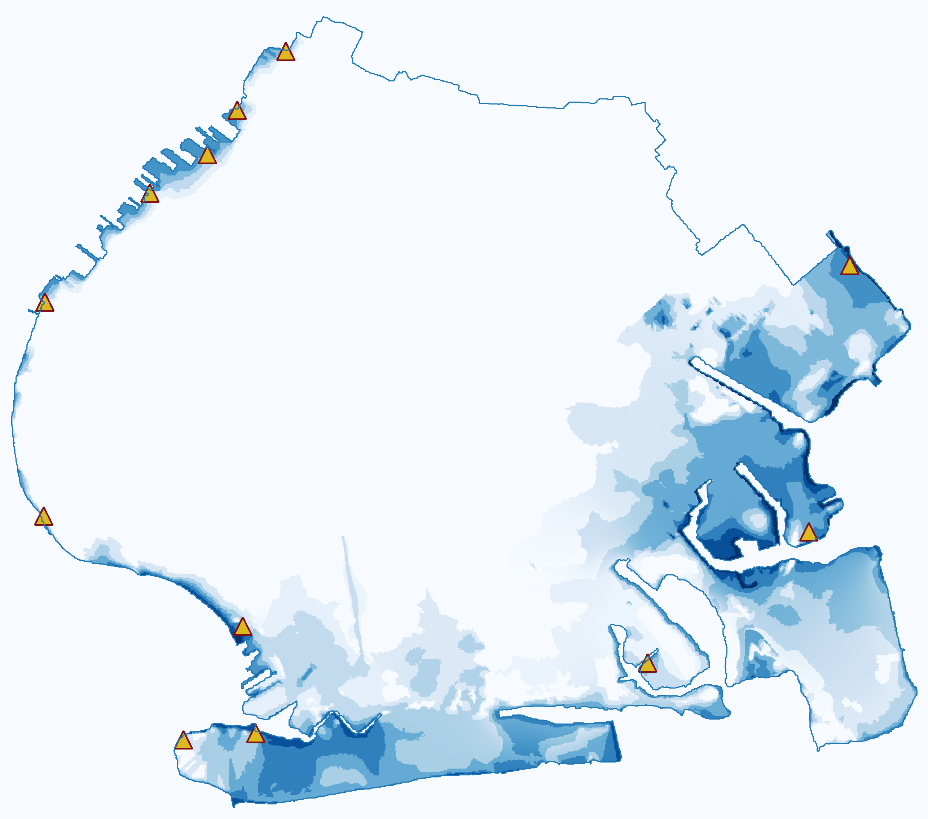

Real Case Study
Drainage network
Flood inundation simulation
Legend
Outfall
WWTP
Observation point
Inundation depth (m)
5.5
Missing pipe and manhole data
0
Simulation took 2.83 wall-clock hours

Slide 7
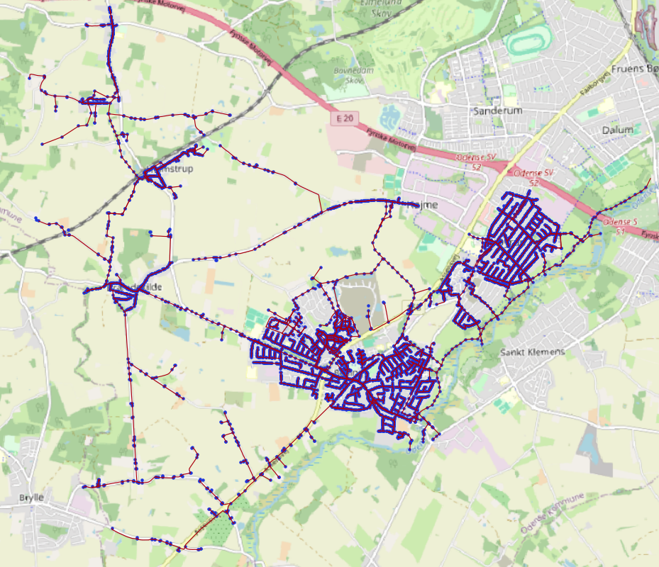
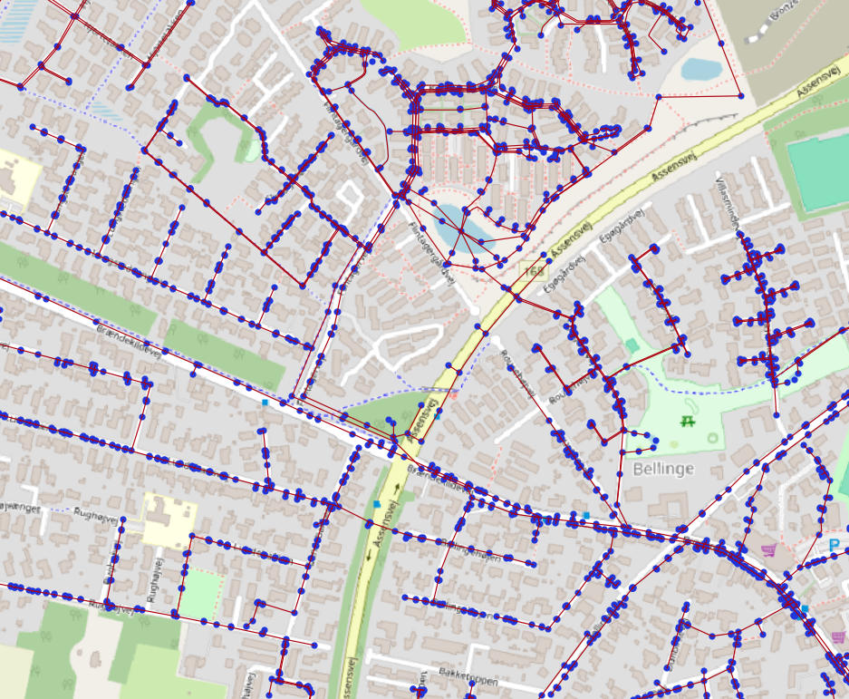
Hypothetical Case Study
Bellinge, Denmark
Covers 1.7 km2 area.
Number of manholes: 995
Number of conduits: 1015
Number of outfalls: 9

Slide 8
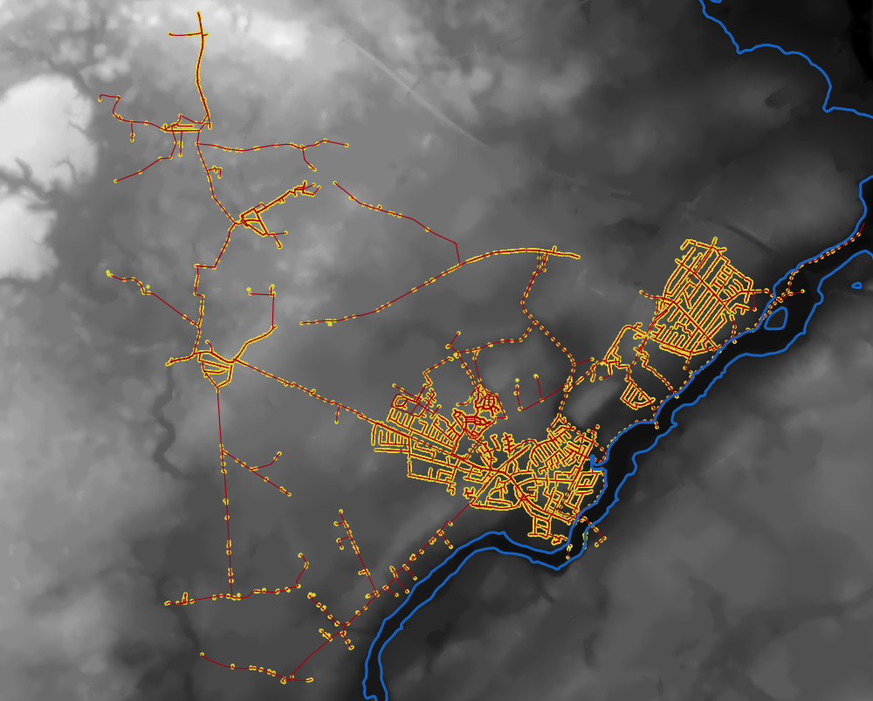
Hypothetical Case Study
River is assumed to be the coastline.
Flood inundation obtained following “bathtub” models and CHS database.

Slide 9
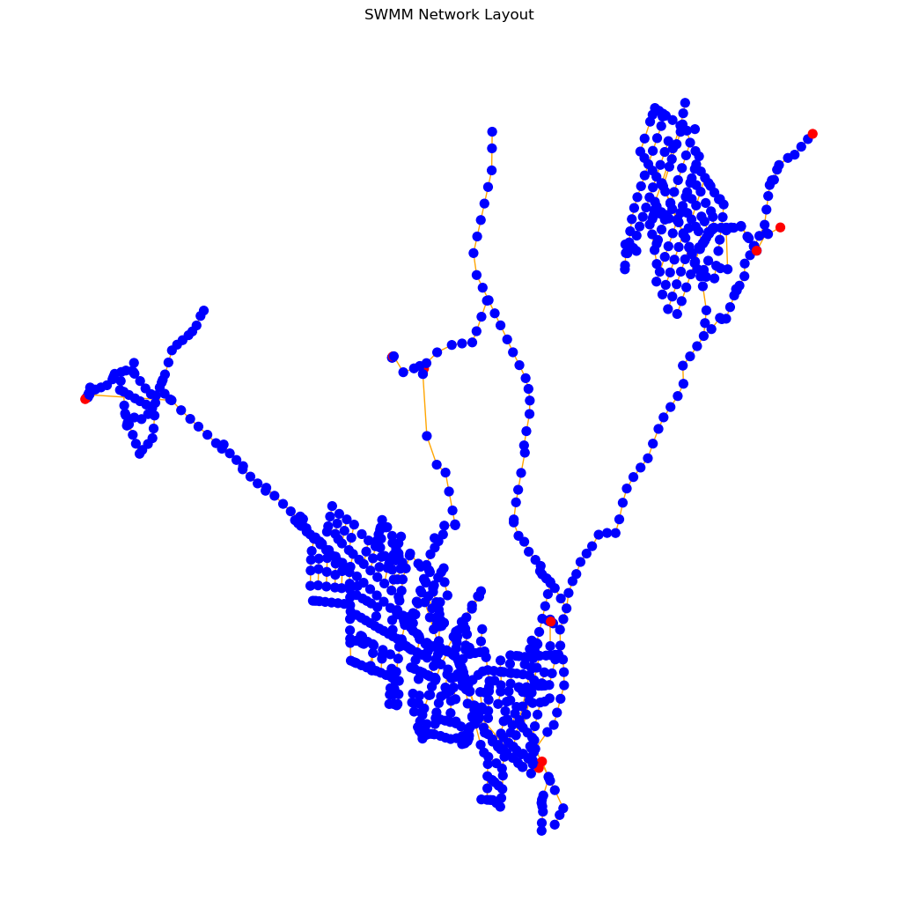
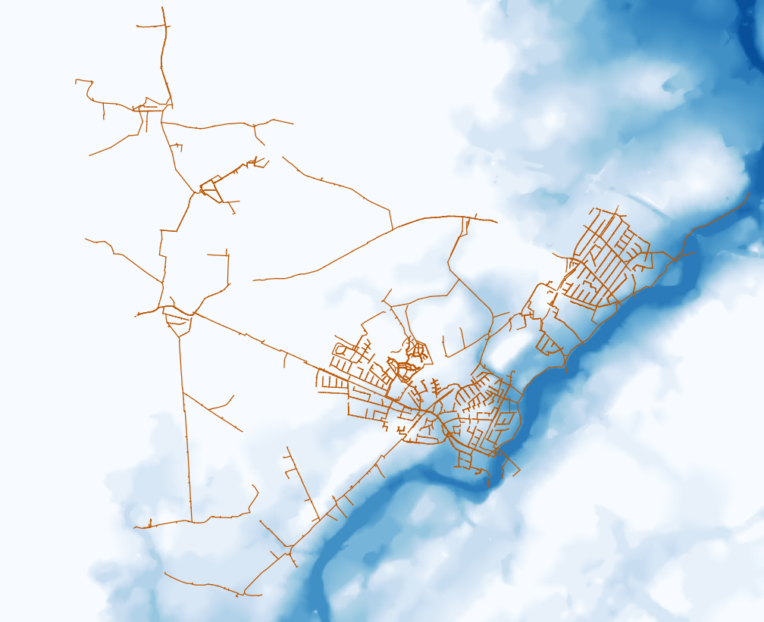
Hypothetical Case Study
SWMM Network model
Inundation time series
Water depth time series at location of nodes
Outfalls
Inundation depth (m)
10
0

Slide 10
Next Steps
SWMM Network model
Simulate SWMM for all flood scenarios
Construct the GNN
Train the GNN based on SWMM

Slide 11
Thank you for your attention

